Slide 1
Improved Warnings for Natural Hazards: A Prototype System for Southern California
Yehuda Bock
Research Geodesist
Scripps Institution of Oceanography
University of California San Diego, La Jolla, CA
Mark Jackson Meteorologist in Charge NOAA/National Weather Service, Los Angeles/Oxnard, CA
Angelyn Moore
Research Scientist
NASA Jet Propulsion Laboratory, Pasadena, CA
AGU Press Conference
December 10, 2013

Slide 2
Research Goal
Saving lives and reducing damage to critical infrastructure from natural hazards, including earthquakes, tsunamis, and extreme storms and flooding.
Approach
Real-time information from geodetic/GPS stations upgraded with small, inexpensive seismic and meteorological sensors is made available to emergency personnel, decision makers, and first responders.

Slide 3
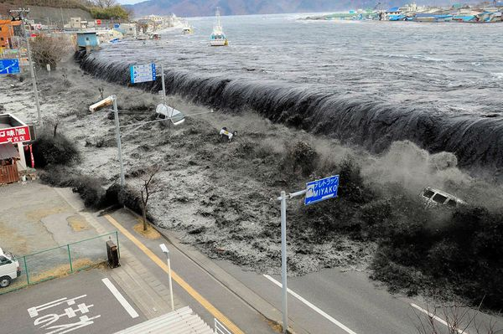
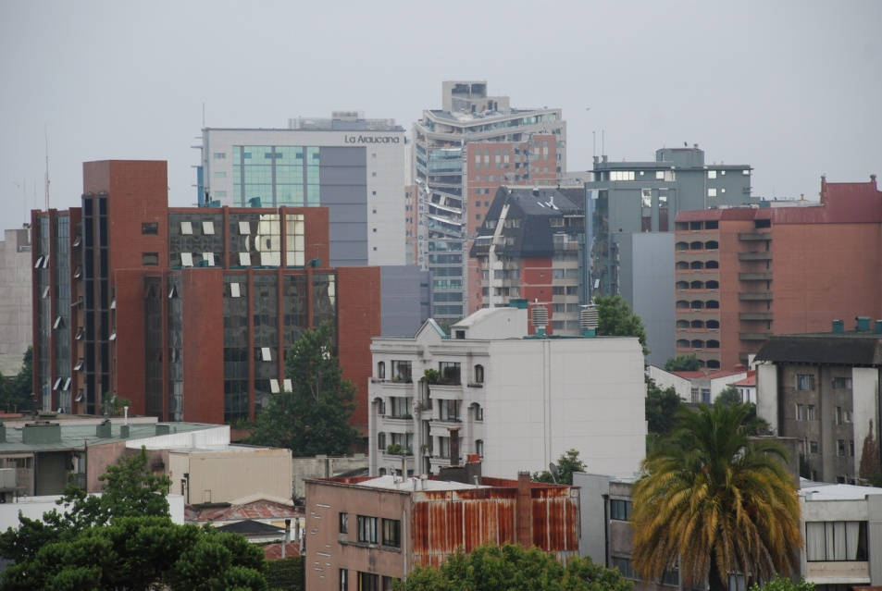
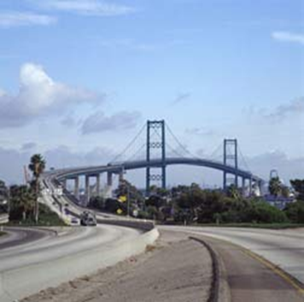
Natural Hazards Risks
Earthquakes/Tsunamis
Structural Collapse
2011 Honshu Japan
Downtown Concepcion, Chile
2010 M8.8 Maule earthquake
(National Geographic)
Extreme Weather
Critical Infrastructure
Vincent Thomas Bridge, Long Beach – in progress for Caltrans (2013)
Summer Monsoon
Notes:
At SIO, we’ve developed the technology for mitigating the effects of natural hazards. Some events we’ve worked on are the devastating 20,11 Honshu earthquake and tsunami in Japan and the Stromboli volcano eruption in 2004 in Italy. Currently, we are applying our technology to monitor the Vincent Thomas Bridge in Los Angeles under contract to Caltrans.

Slide 4
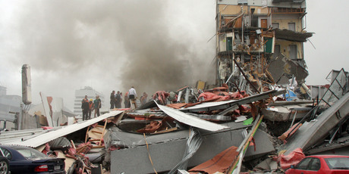
Monitoring Tall Buildings
Collapse of the five-story CTV building in Christchurch, New Zealand during the 2011 Mw 6.1 earthquake resulting in 115 fatalities
Downtown Concepcion, Chile after the 2010 M8.8 Maule earthquake with severely damaged tall buildings leading to loss of life.

Slide 5
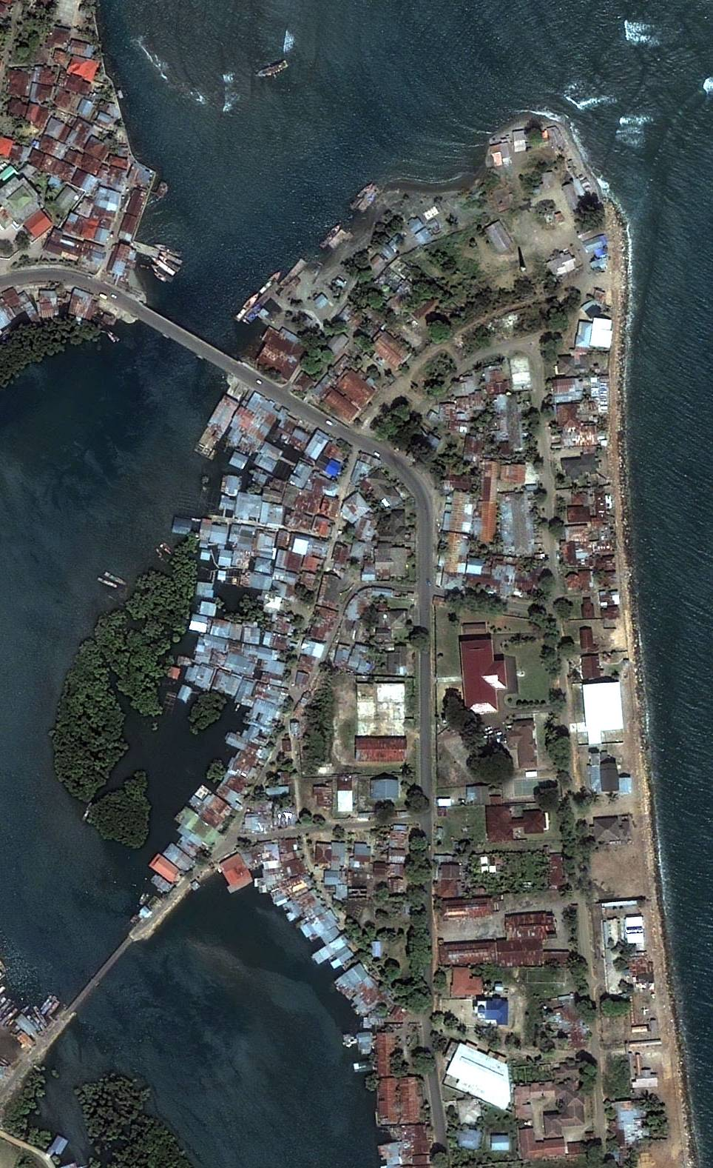
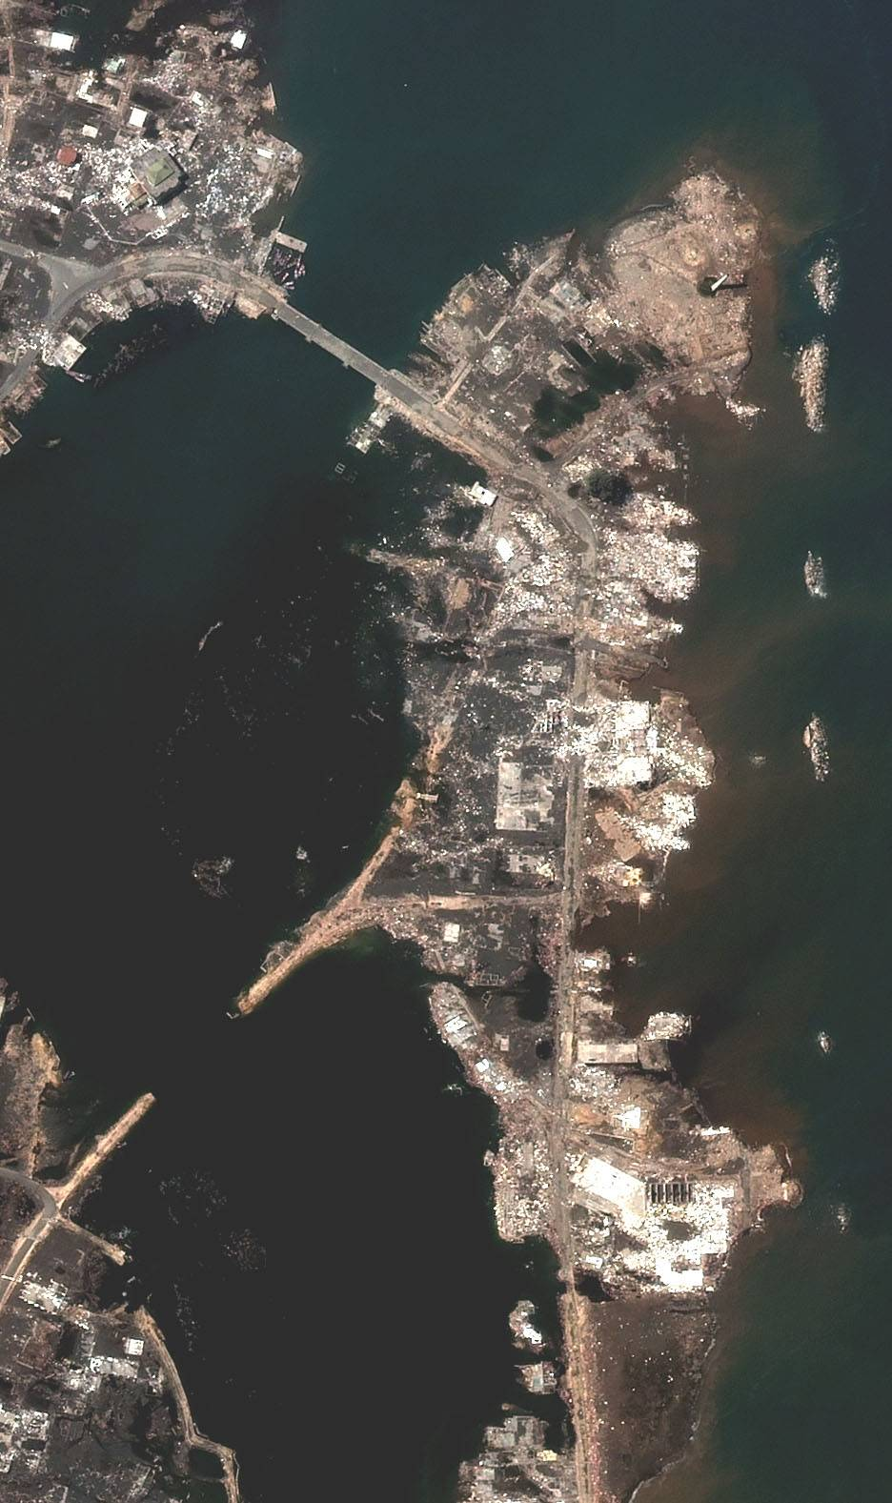
Tsunami Risk
Banda Aceh, Sumatra, Indonesia before 2004 Mw 9.2 Great Sumatra earthquake & tsunami
Banda Aceh after 2004 disaster: 200,000 casualties in Sumatra alone

Slide 6
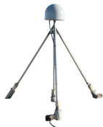
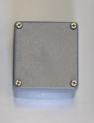
Data Fusion
Enhance precise GPS technology with low-cost sensors to mitigate risk for natural hazards:
Very-high-rate broadband displacements with 1-2 s latency and mm accuracy in three dimensions
+
=
MEMS Accelerometer
Module
GPS/GNSS
Continuous mm-level precipitable water vapor in troposphere
+
=
MEMS Met Sensors
(pressure, temperature)
GPS/GNSS

Slide 7
Shake Table Movie Placeholder

Slide 8
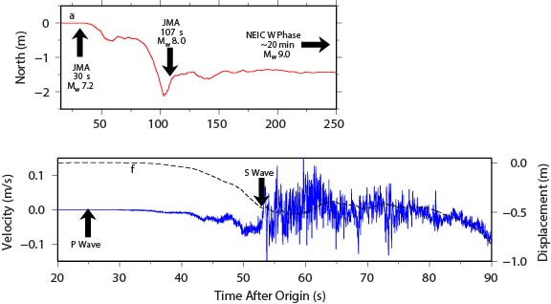
Fusion of GPS & Seismic Data: 2011 Mw 9.0 Tohoku-oki event
Source:
Melgar et al., GRL, 2013

Slide 9
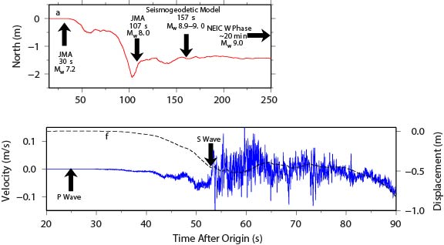
Fusion of GPS & Seismic Data: 2011 Mw 9.0 Tohoku-oki event
Source:
Melgar et al., GRL, 2013

Slide 11
Tsunami Model: 2011 Mw 9.0 Tohoku-oki event
By modeling the earthquake magnitude and fault that ruptured we can estimate uplift of the sea floor to create a model for the tsunami

Slide 12
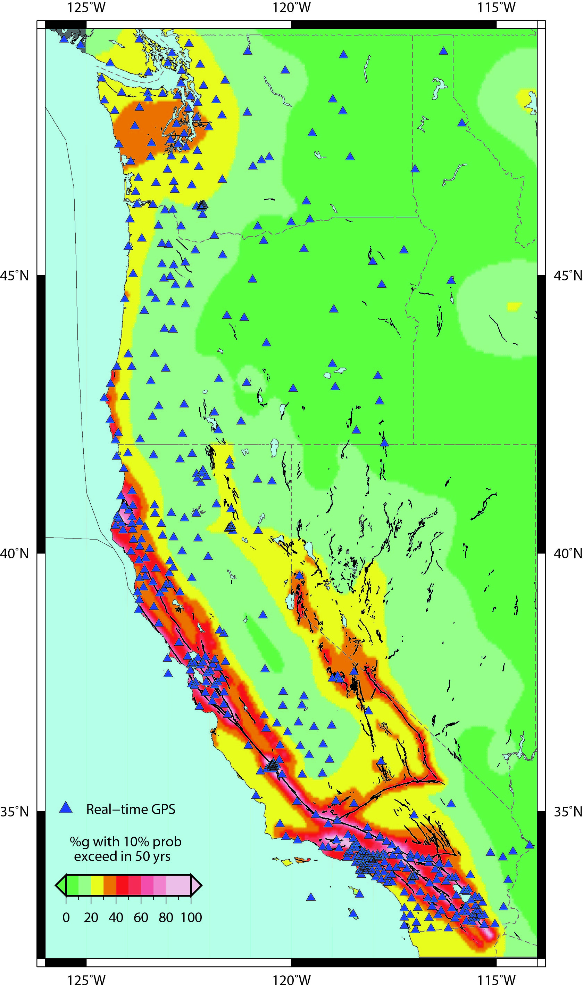
Real-time Precise GPS Network on West Coast
An earthquake & tsunami of the magnitude of Mw 9.0 Tohoku-oki earthquake is possible on Cascadia Subduction Zone
Real-Time Earthquake Analysis for Disaster Mitigation Network (READI), ~600 stations (denoted by triangles) operated by UCSD/SIO, USGS, UC Berkeley, UNAVCO, Central Washington Univ.
There is increasing risk of a large earthquake on the Hayward fault in the Bay Area
We are overdue for a large earthquake on the southern San Andreas fault

Slide 13
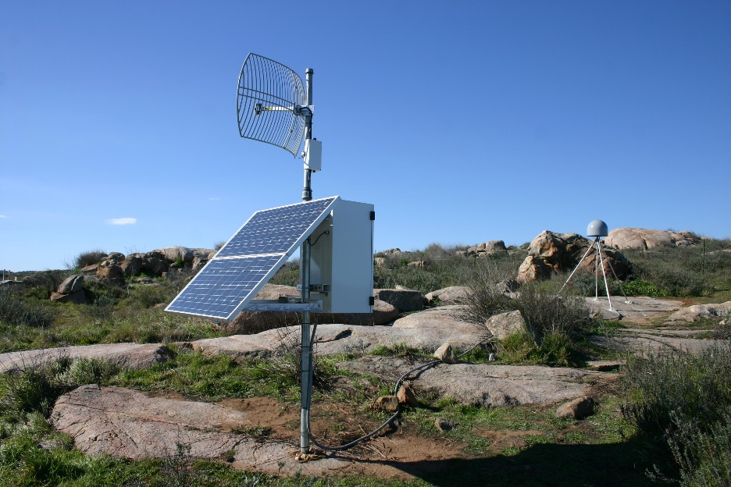
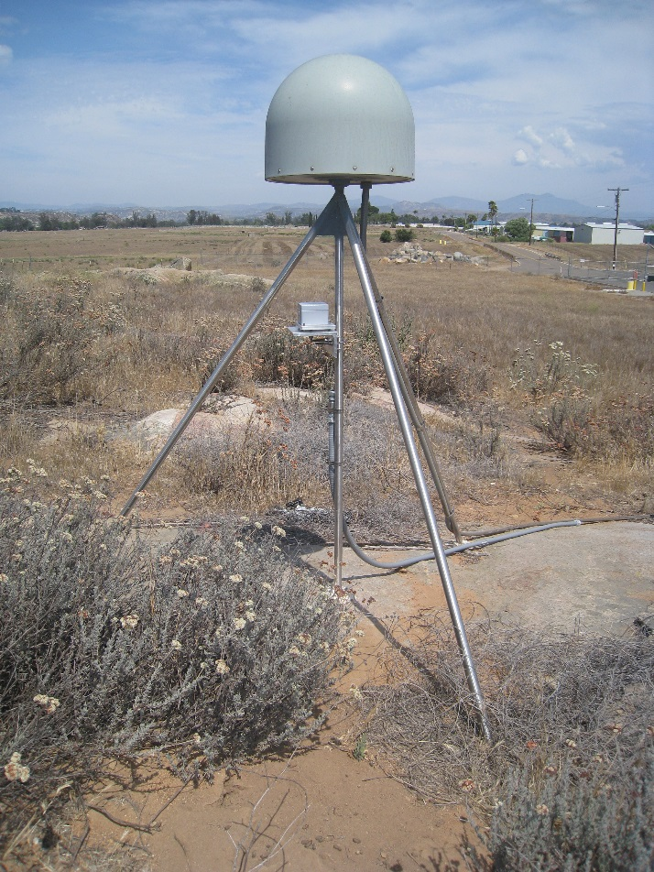
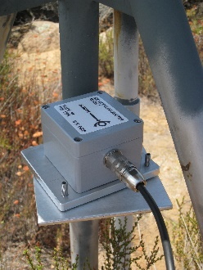
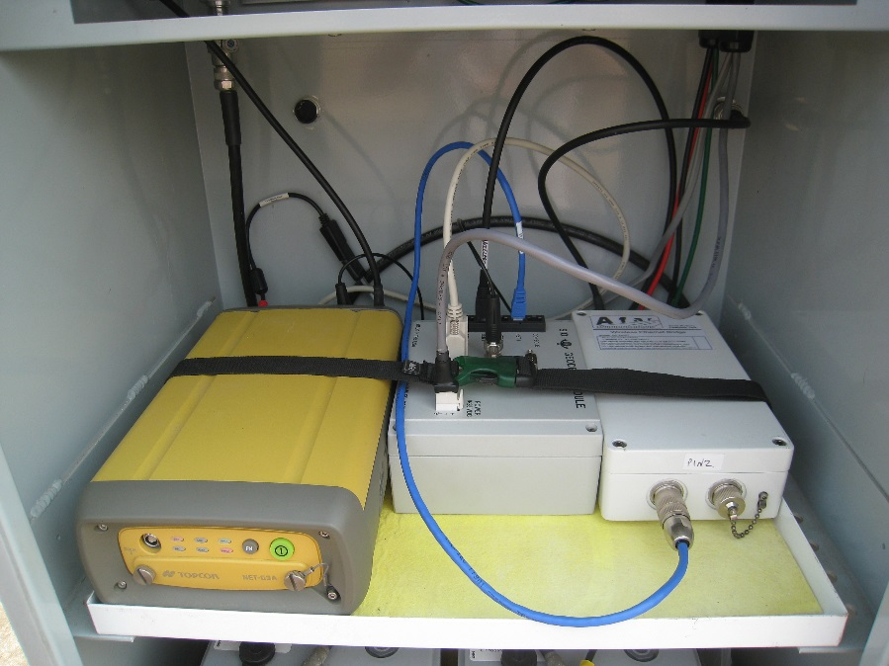
Fusion of GPS and Seismic Data: Seismogeodesy
Upgraded GPS station RAAP
MEMS accelerometer deployed on GPS monument
Geodetic Module in equipment box

Slide 14
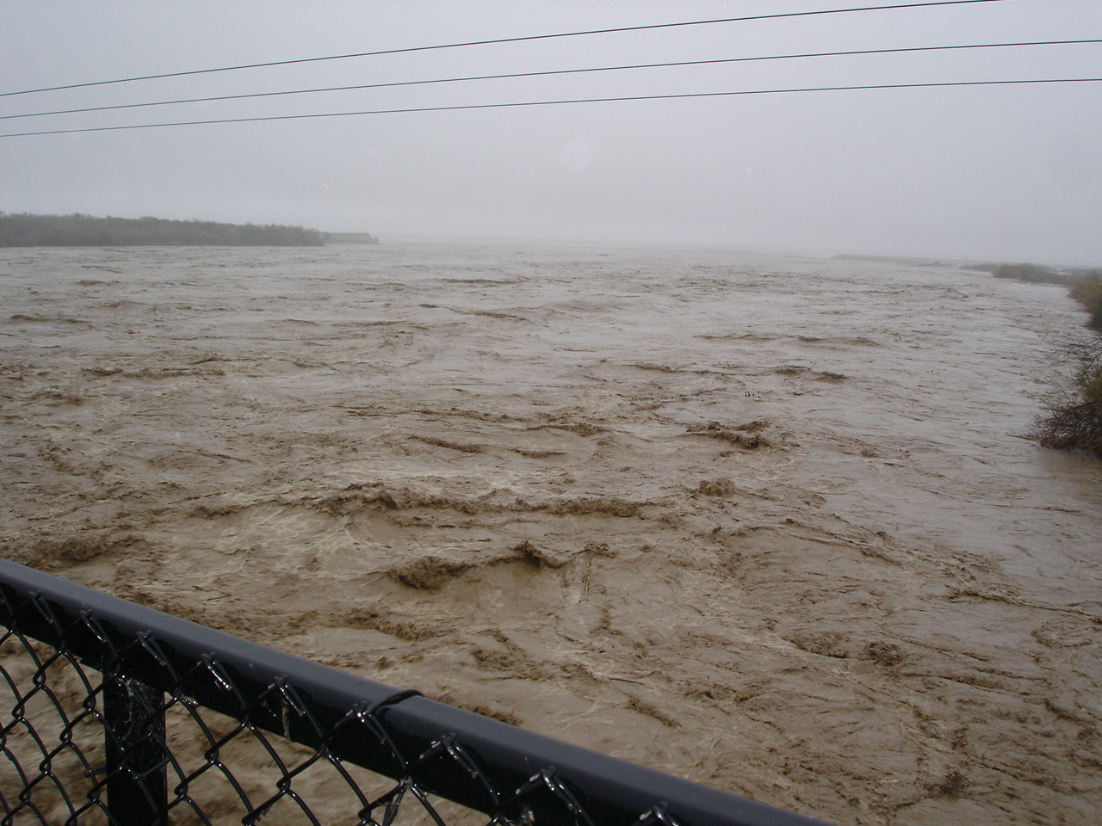
California gets as much rain as the U.S. Gulf Coast gets from hurricanes
Lift plus moisture = Precipitation!
NOAA Photo

Slide 15
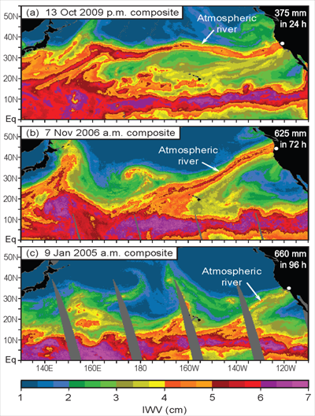
Atmospheric Rivers (AR) are long and narrow streams of atmospheric water vapor that are responsible for many, if not all, winter heavy precipitation events in the Western U.S.
The amount of water in an AR is 7 to 15 times the amount that passes through the mouth of the Mississippi River.

Slide 16
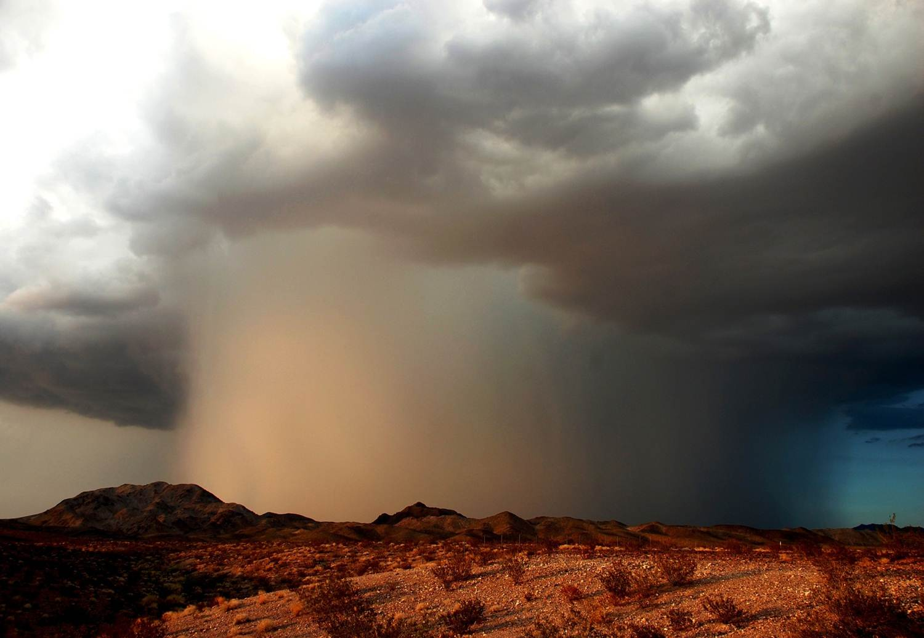
Accurate forecasts and warnings of flash flooding events depends on timely and accurate information of moisture available for intense thunderstorms
Strong thunderstorm with flash flooding near Ludlow, California (Photo Credit: Will Wilkens)

Slide 17
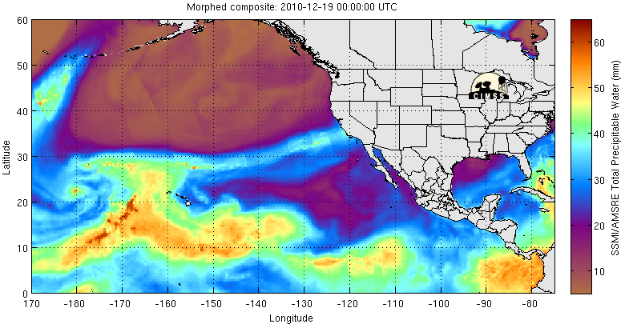
Total Precipitible Water Loop Starts December 18, 2010 Loop Ends December 22, 2010
Moisture Source

Slide 18
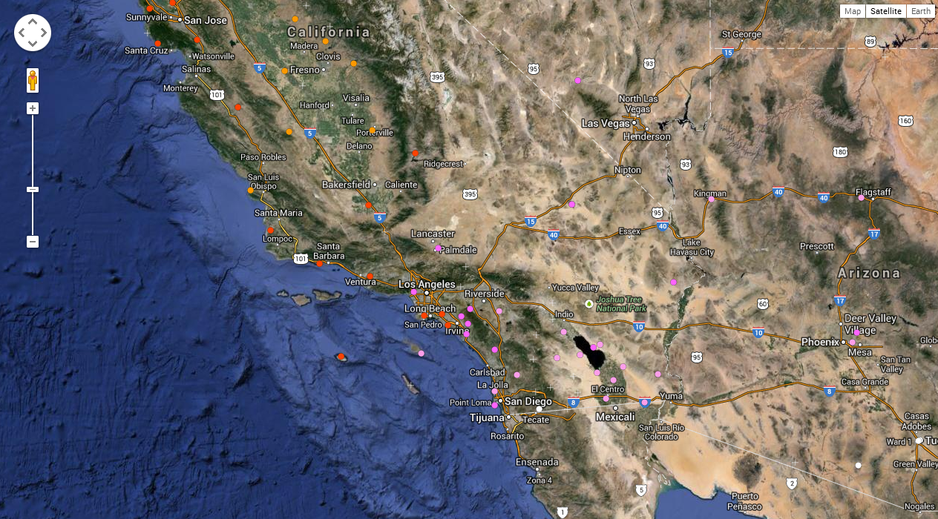
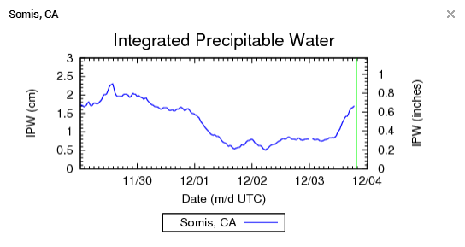
= Radiosonde Balloon sites (max of 2x per day)
= GPS Integrated Precipitable Water sites (1/minute)

Slide 19
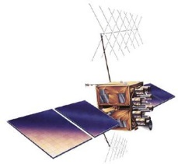
Because signals from the GPS satellites are affected by moist air, when we measure the position of a GPS station, we automatically also measure the atmospheric water vapor above.
Notes:
A GPS station measures the length of time that signals travel from the GPS satellites to the receiving antenna, and through triangulation this determines the position. But the signal travel time is also affected by the amount of water vapor it travels through. This figure is depicting that signals that go through moist air, denoted by a cloud, travel more slowly than signals that go through dry air. Due to this effect, when we measure a GPS station’s precise position, we are automatically also measuring the amount of water vapor in the atmosphere. NASA has invested for many years in JPL and Scripps collaboratively developing technology that measures and utilizes GPS motion and water vapor products, so when this real-time seismology project was shaping up, it was natural for us to include a real-time atmospheric product. The National Weather Service Forecast Offices became our technology infusion partners to exploit this data type for weather forecasting, which Mark will be talking about in detail shortly.

Slide 20
July 2013 North American Monsoon Event
GPS PW
GPS PW (stations boxed at left)
RAP PW
Stage II Blended Precip
Radar (base reflectivity)

Slide 21
Funding and Partners
NASA - ***
NSF - ***
NOAA - ***
National Weather Service partnership, San Diego and Los Angeles – monitoring extreme weather events
San Diego Office of Emergency Services – earthquake and tsunami early warning
UC San Diego Medical Center – monitor Hillcrest hospital and provide early warning
Caltrans – monitor Vincent Thomas bridge, Long Beach Harbor
Notes:
We’ve been awarded about $1.7M from NASA, NSF, NOAA and Caltrans. One of the NASA projects is specifically intended for commercialization of structural monitoring research – our participation today is part of that effort

Slide 22
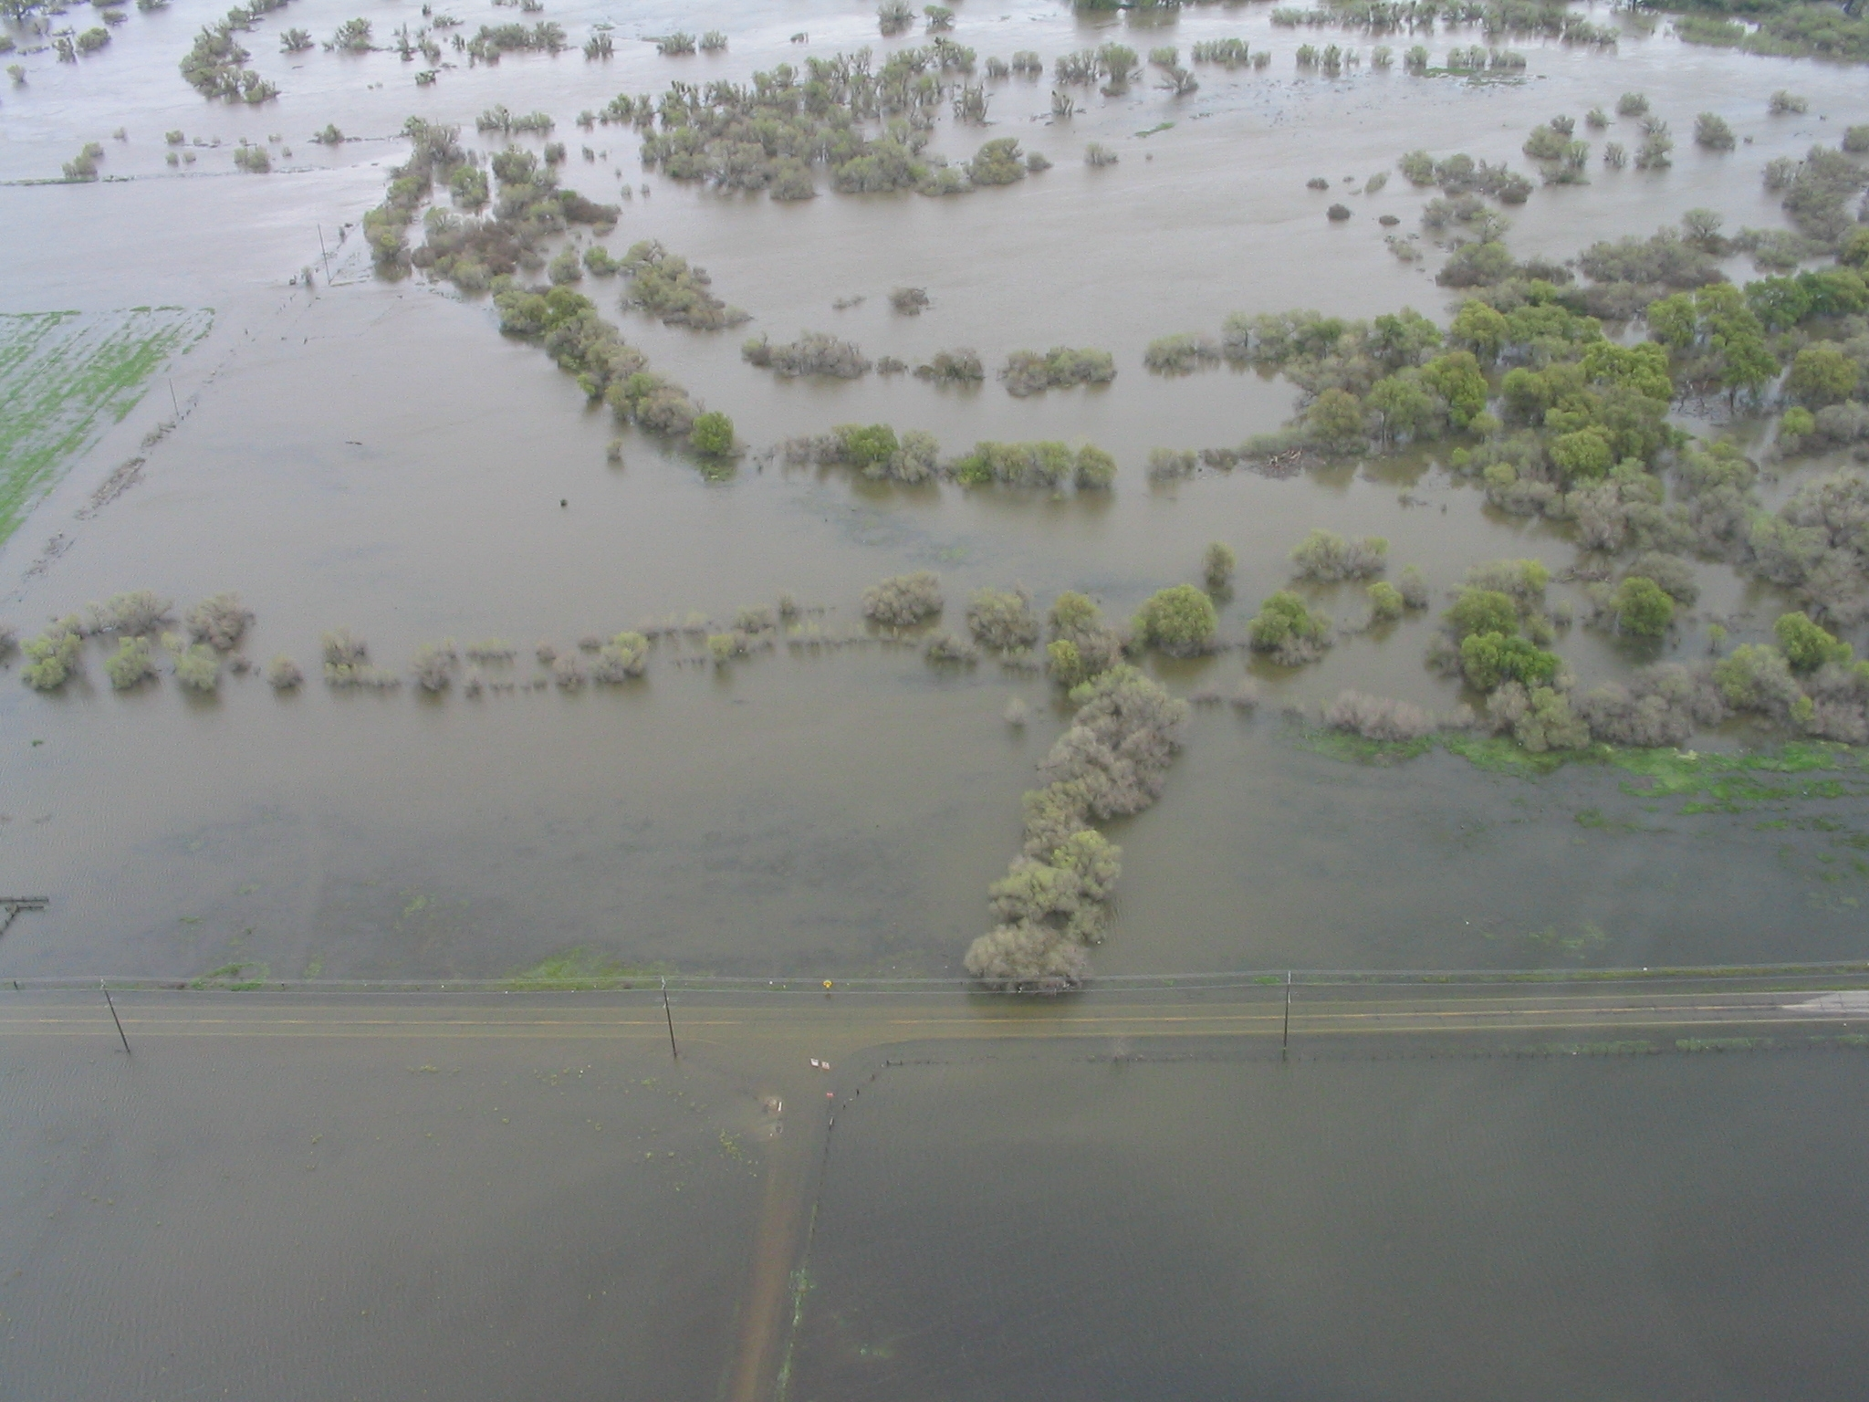
Data, Data, Data
Warning and Forecasting Extreme Precipitation in California
NOAA Photo

